Slide 1
Introduction
Paragraphs 구성
Photonic Integrated Circuits (PICs) based on Silicon-on-Insulator (SOI)에 대한 관심 증폭[1]
Integrated component에서 power splitter는 필수
“beyond 5G” generation에서 THz optical device의 중요성[2, 3]
THz optical device example: Subwavelength Graphene waveguide (30 THz)[4], Multi-output splitter without grating structure, Genetic Algorithm[5]
기존에는 analytically designed structure를 바탕으로 몇가지 parameters를 조절하는 방법으로 설계
Example: Direct Binary Search [6], self-imaging[7, 8, 9], sweep parameter based on specific structure[10]
제한된 설계 조건, Performance 한계
최근 machine learning을 활용한 design 방법
Example: Alternating Directions Method of Multipliers (ADMM) optimization[11, 12, 13], Artificial Neural Networks [14, 15]
위의 방법들로 splitter를 설계할 경우 arbitrary ratio output에 대해서도 설계가 가능하다는 장점이 있지만, training data를 생성한 이후에도 optimization 을 수행하기 위한 시간이 필요하다. 하지만 본 논문에서 사용한 알고리즘은 training data를 확보한 상태라면 짧은 시간안에, optimization step 없이 최종 구조물을 얻을 수 있다.
In this study,
Photonic Integrated Circuits review paper - L. Thylén and L. Wosinski, “Integrated photonics in the 21st century,” Photonics Research, vol. 2, no. 2, p. 75, Jan. 2014.
THz communication, 504 citation - I. F. Akyildiz, J. M. Jornet, and C. Han, “Terahertz band: Next frontier for wireless communications,” Physical Communication, vol. 12, pp. 16–32, 2014.
THz communication recent paper, arxiv 2019 - E. Calvanese Strinati et al., "6G: The Next Frontier: From Holographic Messaging to Artificial Intelligence Using Subterahertz and Visible Light Communication," in IEEE Vehicular Technology Magazine, vol. 14, no. 3, pp. 42-50, Sept. 2019
Subwavelength Graphene waveguide (30 THz) - Z. Guo, X. Nie, F. Shen, H. Zhou, Q. Zhou, J. Gao, and K. Guo, “Actively Tunable Terahertz Switches Based on Subwavelength Graphene Waveguide,” Nanomaterials, vol. 8, no. 9, p. 665, 2018.
Multi-output splitter without grating structure, Genetic Algorithm - F. Zhang, K. Song, and Y. Fan, “New 2D diffraction model and its applications to terahertz parallel-plate waveguide power splitters,” Scientific Reports, vol. 7, no. 1, Sep. 2017.
Direct Binary Search algorithm - L. Lu, M. Zhang, F. Zhou, and D. Liu, “An Ultra-compact Colorless 50:50 Coupler Based on PhC-like Metamaterial Structure,” Optical Fiber Communication Conference, 2016.
Self-imaging, NxN multimode - M. Bachmann, P. A. Besse, and H. Melchior, “General self-imaging properties in N × N multimode interference couplers including phase relations,” Applied Optics, vol. 33, no. 18, p. 3905, 1994.
Self-imaging, multimode, review - L. Soldano and E. Pennings, “Optical multi-mode interference devices based on self-imaging: principles and applications,” Journal of Lightwave Technology, vol. 13, no. 4, pp. 615–627, 1995.
Analytic method - Eigenmode decomposition theory - Y. Tian, J. Qiu, M. Yu, Z. Huang, Y. Qiao, Z. Dong, and J. Wu, “Broadband 1 × 3 Couplers With Variable Splitting Ratio Using Cascaded Step-Size MMI,” IEEE Photonics Journal, vol. 10, no. 3, pp. 1–8, 2018.
Butterfly geometry - P. Besse, E. Gini, M. Bachmann, and H. Melchior, “New 2×2 and 1×3 multimode interference couplers with free selection of power splitting ratios,” Journal of Lightwave Technology, vol. 14, no. 10, pp. 2286–2293, 1996.
Machine Learning_Alternating Directions Method of Multipliers (ADMM) optimization algorithm - A. Y. Piggott, J. Lu, K. G. Lagoudakis, J. Petykiewicz, T. M. Babinec, and J. Vučković, “Inverse design and demonstration of a compact and broadband on-chip wavelength demultiplexer,” Nature Photonics, vol. 9, no. 6, pp. 374–377, 2015.
Machine Learning_Alternating Directions Method of Multipliers (ADMM) optimization algorithm, T-shape Polarizatino Beamsplitter - Z. Ye, J. Qiu, C. Meng, L. Zheng, Z. Dong, and J. Wu, “Inverse Design of a SOI T-junction Polarization Beamsplitter,” Journal of Physics: Conference Series, vol. 844, p. 012009, 2017.
Machine Learning_Alternating Directions Method of Multipliers (ADMM) optimization algorithm - A. Y. Piggott, J. Petykiewicz, L. Su, and J. Vučković, “Fabrication-constrained nanophotonic inverse design,” Scientific Reports, vol. 7, no. 1, Nov. 2017.
Deep Learning_ResNet algorithm (without Convolutional Networks) - M. H. Tahersima, K. Kojima, T. Koike-Akino, D. Jha, B. Wang, C. Lin, and K. Parsons, “Deep Neural Network Inverse Design of Integrated Photonic Power Splitters,” Scientific Reports, vol. 9, no. 1, 2019.
Deep Learning_Covolutional Neural Network(CNN) algorithm - M. H. Tahersima, K. Kojima, T. Koike-Akino, D. Jha, B. Wang, C. Lin, and K. Parsons, “Nanostructured Photonic Power Splitter Design via Convolutional Neural Networks,” Conference on Lasers and Electro-Optics, 2019.

Slide 2
Method
Paragraphs 구성
Perceptron-like machine learning algorithm[16]
“The algorithm combines the additive updates feature of the perceptron algorithm and the reward for state idea of reinforcement learning”[17]
20 x 10 binary matrix by symmetry
“1” for etched (air), “0” for not etched (Si)
Reward = min(T1) + min(T2) - |R|, maximize given reward
The algorithm consist of two phases: training and inference.
Training Phase: Generate training data and accumulate the rewards in a summation matrix
Inference Phase: normalizing and applying activation function to the summation matrix
Figure: Algorithm flowchart
C. Latifoglu, “Binary matrix guessing problem,” Jan. 2017. [Online]. Available: arXiv: e-prints, vol.1701.06167
M. Turduev, E. Bor, C. Latifoglu, I. H. Giden, Y. S. Hanay, and H. Kurt, “Ultracompact Photonic Structure Design for Strong Light Confinement and Coupling Into Nanowaveguide,” Journal of Lightwave Technology, vol. 36, no. 14, pp. 2812–2819, 2018.

Slide 3
Figure: Algorithm flowchart
Generate Training Data
Training Phase
Reward Calculation and
Data Storage
Inference Phase
Analyzing Stored Data
Final Photonic Structure

Slide 4

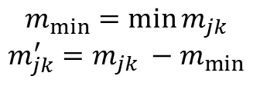
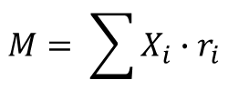

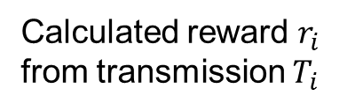
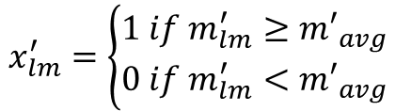

Training Phase
Binary matrix
1 for etched (air)
0 for not etched (Si)
Calculated reward $r_{i}$
from transmission $T_{i}$
$$X_{i}= \left(\begin{aligned}1 1 0 0 ⋯11 \\ 1 1 0 0 ⋯11 \\ ⋮ ⋱ ⋮ \\ 1 1 1 1 ⋯1 1\end{aligned}\right)$$
$$X_{i}, r_{i}$$
Inference Phase
Accumulate the reward in a summation matrix M
$$M= \sum{X_{i}∙r_{i}}$$
Normalizing summation matrix M’
$$m_{min}=\min{m_{jk}}$$
$$m_{jk}^{′}=m_{jk} −m_{min}$$
Activation function
$$x_{lm}^{′}$$
$${m′}_{avg}=\frac{\sum{{m′}_{jk}}}{N′}$$
1
$$x_{lm}^{′}=\left\{\begin{aligned}1 if m_{lm}^{′}≥{m′}_{avg} \\ 0 if m_{lm}^{′}<{m′}_{avg}\end{aligned}\right.$$
0
$${m′}_{avg}$$
$$m_{jk}$$

Slide 5
Method
Paragraphs 구성
Integrated photonic 1x2 power splitter
Not a arbitrary device, fixed size.
2D FDTD simulation for time-saving
SOI platform: 9 um radii, 20x20 air-hole on 500 um box
not aim to maximize the operation bandwidth, broadband transmission 275 ~ 325 um
Fundamental TE mode, 1:1 uniform
Refractive index is fixed to n_{Si} = 3.41.
Figure: Design base structure and condition
Generate labeled data for training phase
Commercially available software Lumerical FDTD solutions
2 Intel Xeon CPU with 2.5 GHz clock speed and 383 GB RAM about 3 days to complete collecting 30,000 simulation data
Figure: Data transmission distribution

Slide 6
Figure: Design base structure and condition
T
T
: Etched
: Not Etched
Input

Slide 7
Result & Discussion
Paragraphs 구성
“The two key criteria for a power splitter are low insertion loss, and excellent power uniformity.”[11]
The power uniformity = the ratio between the maximum and minimum
Figure: design result (structure, spectrum, power distribution)

Slide 8
Figure: design result (structure, spectrum, power distribution)

Slide 10
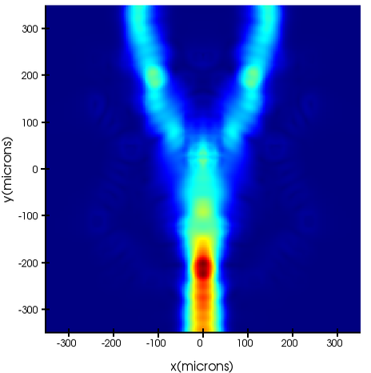

Slide 11
Machine Learning과 Deep Learning의 관계
Artificial Intelligence
Machine Learning
Deep Learning
Machine Learning:
Machine Learning is the study of computer algorithms that improve automatically through experience.
Deep Learning:
Deep learning is a particular kind of machine learning that achieves great power and flexibility by learning to represent the world as nested hierarchy of concepts, with each concept defined in relation to simpler concepts, and more abstract representations computed in terms of less abstract ones
Machine Learning definition
T. M. Mitchell, Machine Learning. New York: McGraw-Hill, 1997.
Deep Learning categorization review
Y. Lecun, Y. Bengio, and G. Hinton, “Deep learning,” Nature, vol. 521, no. 7553, pp. 436–444, 2015.

